Slide 1
Active Learning and Practical
Knowledge
Alex Aberg Cobo, JD, MBA
Managing Director, Latin America
alex@minervaproject.com

Slide 2
Minerva Goals
Rethink higher education to better prepare students as leaders and innovators for an uncertain global future
Notes:
The world is more complex and interconnected than ever before
Digital technology is increasing the pace of change

Slide 3
International students are an underrepresented minority at the top universities in the world
Source: Academic Ranking of World Universities at http://www.shanghairanking.com

Slide 4
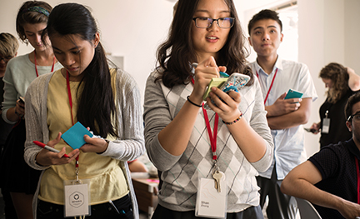



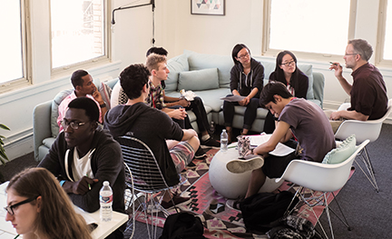

International Student Body

Slide 5

San Francisco
Berlin
Buenos Aires
Seoul
Bangalore
Istanbul
London
7 cities
during four years of intensive study.
Image: Data visualization showing global flight patterns by Michael Markieta
Notes:
Minerva students live and learn in seven of the world’s greatest cities.

Slide 6
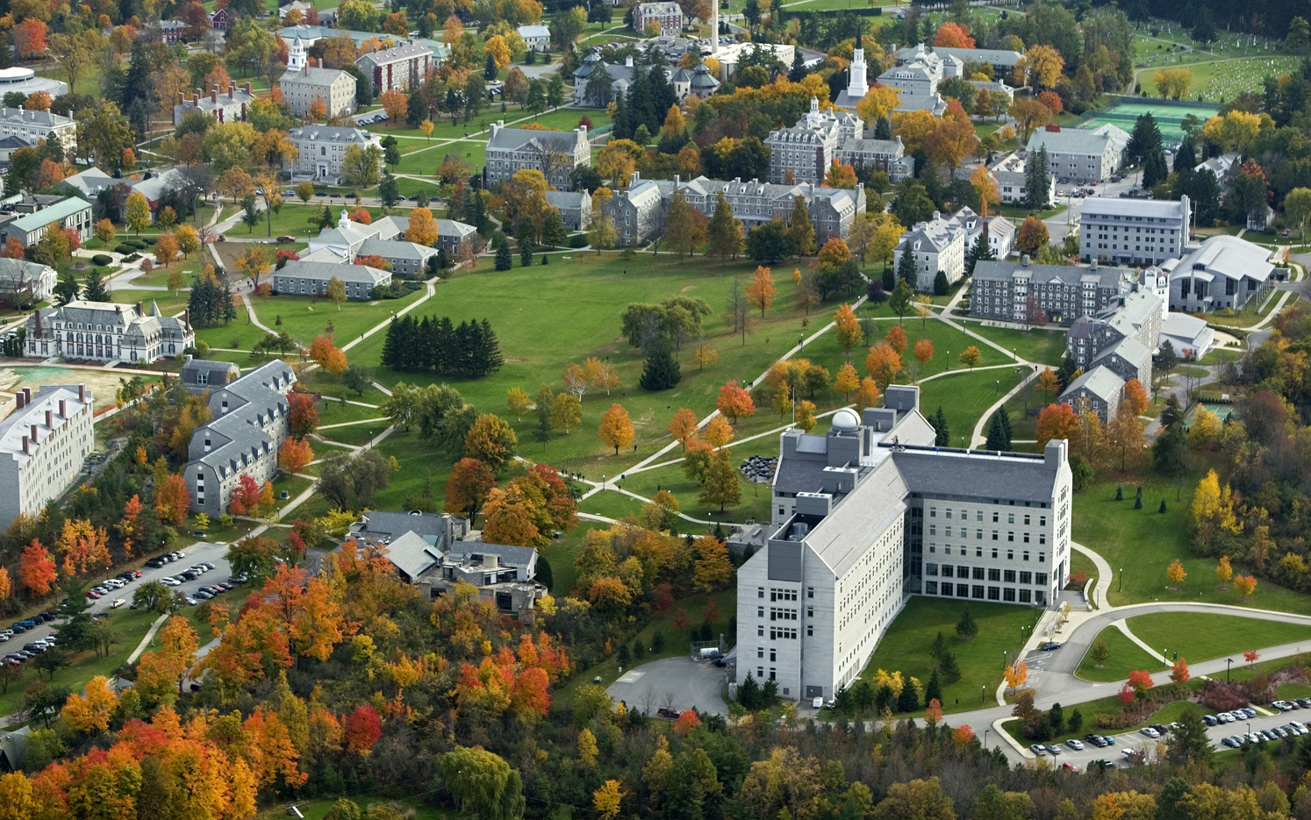
NO CAMPUS
Notes:
What % of college students study abroad? According to NAFSA only 1.4% of students enrolled in college study abroad and >50% go to europe. http://www.nafsa.org/_/File/_/studyabroad_statebystate_2012-2013.pdf. http://www.nafsa.org/explore_international_education/advocacy_and_public_policy/study_abroad/trends_in_u_s__study_abroad/

Slide 7
Cultural Engagement
Extracurricular Activities
Example
Help serve meals at a
local homeless shelter
Co-curricular Activities
Example
Meet with Cecil Williams to learn about the history of homelessness in SF
Location-based Assignments
Example
Meet with the SF Homelessness Committee; work on solutions taking into account facts about complex systems (e.g., emergent properties)

Slide 8
2015 Admissions Data
11,000
Worldwide Applicants
160
Different Countries
220
Admitted Students
2%
Admissions Rate
111
Matriculated Students
30
Different Countries
Notes:
Including a small group of students who chose to defer matriculation to September 2016, Minerva’s regular decision yield is at or above that of seven in the eight Ivy League universities

Slide 9
Teaching Practical Knowledge
Notes:
The curriculum is designed to continuously reinforce these learning objectives through all four years of study
By developing mental habits students have a powerful foundation for building expertise
We emphasize mastery, not memorization

Slide 10
Aspects of Four Core Competencies
Examples
critical thinking
evaluating claims
weighing decisions
creative thinking
solving problems
facilitating discovery
effective communication
writing clearly
presenting
effective interaction
negotiating
working on teams

Slide 12
Fundamental knowledge and skills cannot easily be learned in lectures.
Lectures are a great way to teach, but a terrible way to learn.

Slide 13

No Classroom
Content-based curriculum
Notes:
What % of information do students retain after two years when taught in a lecture? estimates vary but the generally accepted # is 5%

Slide 14
Active Learning and Interactive seminars
capped at 18 students
empirically motivated
16 principles applied

Slide 15
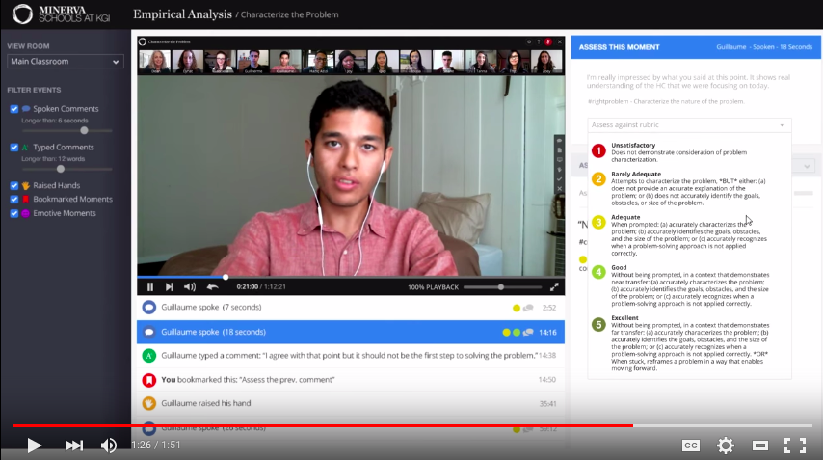
Minerva’s Classroom
Classroom
Notes:
What % of information do students retain after two years when taught in a lecture? estimates vary but the generally accepted # is 5%

Slide 16
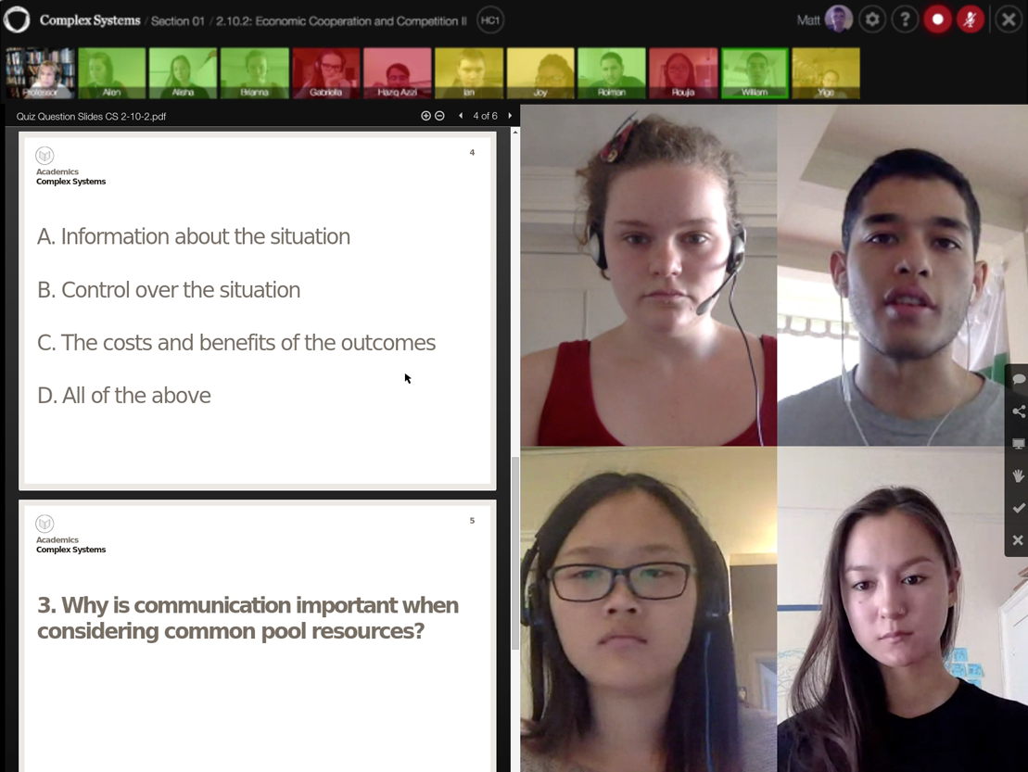

Slide 17








First-year Student Internship Examples
Notes:
Minerva has helped its Founding Class students secure internships with top organizations, across industries — from technology and finance to science and the arts

Slide 18
Five Parts of the Admissions Process
Application Form
Assessments
Accomplishments
Transcripts
Video Evaluation
In this first portion of the process, you share basic information about yourself and your academic history. The online form is clear, simple and free to submit.
The assessments consist of proprietary online tests devised to gauge your ability to process information in various ways.
During this part, you will be asked to share details about the achievements you are most proud of, together with documentation and supporting evidence.
In this portion, you will submit your academic transcript(s) and a counselor report from the school you currently attend.
This portion of the application process is a video evaluation, during which you answer a series of questions about yourself, followed by a brief writing exercise, all while on camera.
~30 minutes
~45 minutes
~60 minutes
~15 minutes
~45 minutes

Slide 19
Apply Now http://bit.ly/1mkzGAh
Alex Aberg Cobo, JD, MBA
Managing Director, Latin America
alex@minervaproject.com

